Slide 1
Student Name
Rajeshkumar.S
3rd year B.E.CSE
NM ID :au421221104032
Email ID : rajehkumarmala3@gmail.com
3/21/2024 Annual Review

Slide 2
PROJECT TITLE:
NUMBER GENERATION GANs -MNIST
3/21/2024 Annual Review
Notes:
Ghj

Slide 3


AGENDA
Problem Statement
Project Overview
Who Are The End Users?
Solution And Its Value Proposition
The Wow In Solution
Modelling
Results
3/21/2024 Annual Review

Slide 4

PROBLEM STATEMENT
The problem is to train a Generative Adversarial Network (GAN) to generate realistic-looking handwritten digits using the MNIST dataset. The generator learns to produce synthetic images resembling digits, while the discriminator learns to distinguish between real and fake images. The objective is to train the generator to produce high-quality digit images indistinguishable from real ones.
3/21/2024 Annual Review

Slide 5

PROJECT OVERVIEW
The project aims to utilize Generative Adversarial Networks (GANs) to generate realistic handwritten digits, leveraging the MNIST dataset. Through this, the generator component of the GAN learns to produce synthetic images closely resembling handwritten digits, while the discriminator learns to differentiate between real and fake images. The ultimate goal is to train the GAN model to generate high-quality digit images that are visually indistinguishable from real ones.
3/21/2024 Annual Review

Slide 6

WHO ARE THE END USERS?
The end users of GANs number generation encompass a broad spectrum of individuals and organizations.
They include: 1.Researchers 2.Developers 3.businesses 4.educators 5.Data scientists 6.Enthusiasts
3/21/2024 Annual Review

Slide 7

SOLUTION AND ITS VALUE PROPOSITION
Realistic Image Generation:
GANs can generate high-quality, realistic images of handwritten digits that closely resemble those in the MNIST dataset.
Data Augmentation:
GAN-generated images can be used to augment training datasets for machine learning models, enhancing model performance and generalization.
3/21/2024 Annual Review

Slide 8

THE WOW IN SOLUTION
Our solution harnesses the power of Generative Adversarial Networks (GANs) to revolutionize number generation using the MNIST dataset.
Here's the wow: 1.Hyper realistic images 2.Endless creativity 3.Supercharged data augmentation 4.Cost effective innovation
3/21/2024 Annual Review

Slide 9
MODELLING
Modelling GANs for number generation involves crafting a generator network to produce realistic digit images from random noise, alongside a discriminator network trained to differentiate between real and generated images. Through adversarial training, the generator refines its output to deceive the discriminator, resulting in high-quality synthetic digit images. Fine-tuning and evaluation ensure the model generates accurate representations of handwritten digits, ready for deployment in various applications.
3/21/2024 Annual Review

Slide 10
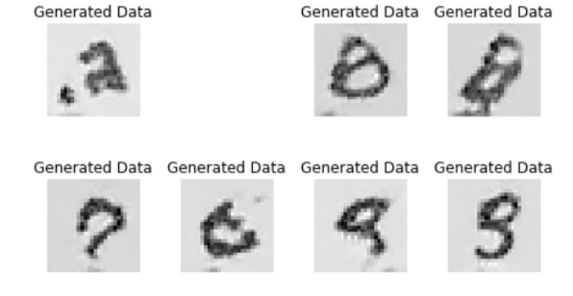
RESULTS
Our GANs model successfully generates lifelike handwritten digit images with remarkable realism and diversity.
OUTPUT
Demo Link
3/21/2024 Annual Review

